Slide 1

The History of Artificial Intelligence: From Ancient Automata to Agentic AI

Slide 2
Ancient Roots: Automata and Early Ideas of Artificial Intelligence
The concept of machines mimicking human actions dates back millennia. Ancient civilizations dreamed of automatons, self-operating machines that could perform tasks autonomously. These early innovations laid the philosophical groundwork for what would eventually become artificial intelligence.
400 BCE
1
Archytas's Mechanical Pigeon: A wooden, steam-powered bird that could fly, demonstrating early mechanical ingenuity.
2
9th Century
Banū Mūsā Brothers: Developed programmable musical automata, showcasing advanced engineering for their time.
1206
3
Al-Jazari's Orchestra: An intricate, programmable boat with four robotic musicians, a testament to early robotics.

Slide 3

The Birth of Modern AI: Turing and Dartmouth (1950s)
The mid-20th century marked the official genesis of AI as a scientific discipline. Visionaries like Alan Turing began to formalize the idea of machine intelligence, and a pivotal conference brought together the minds that would shape its future.
1950: Alan Turing
Published "Computing Machinery and Intelligence," introducing the Turing Test as a benchmark for machine intelligence.
1956: Dartmouth Conference
John McCarthy coined the term "Artificial Intelligence," establishing AI as a formal field of research.
Early Neural Networks
Marvin Minsky and Dean Edmonds created SNARC in 1951, simulating 40 neurons with vacuum tubes – a precursor to modern neural nets.

Slide 4


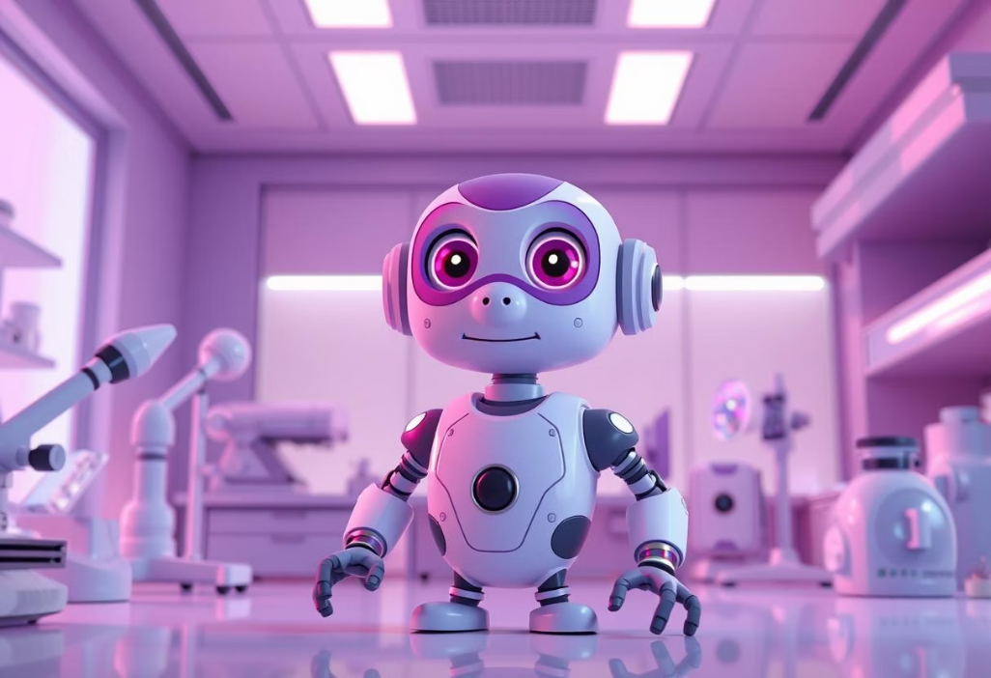


Early Milestones: Perceptron, ELIZA, and Shakey (1957–1966)
1966: Shakey the Robot
1966: ELIZA Chatbot
Shakey, the first mobile robot to reason about its own actions, integrated perception and planning, laying groundwork for autonomous systems.
1957: The Perceptron
Joseph Weizenbaum created ELIZA, a program that simulated human conversation, pioneering natural language processing and human-computer interaction.
Frank Rosenblatt developed the Perceptron, a foundational neural network capable of learning basic patterns, marking a step towards machine learning.

Slide 5

AI Winters and Expert Systems (1970s–1980s)
The initial enthusiasm for AI faced challenges, leading to periods of reduced funding and interest known as "AI Winters." However, these periods also spurred the development of more practical and specialized AI applications like expert systems.
The First AI Winter
Expert Systems Emerge
In the 1970s, limitations of early neural networks and over-optimistic predictions led to significant funding cuts and a decline in AI research.
The 1980s saw a resurgence with rule-based Expert Systems, which mimicked human expert decision-making in specific domains.
MYCIN Example
One notable example, MYCIN, could diagnose infectious diseases with accuracy comparable to human specialists.
Lisp Programming
The Lisp programming language, created by John McCarthy, became a standard for AI development during this era, enabling complex symbolic reasoning.

Slide 6




Machine Learning and Deep Learning Rise (1990s–2010s)
The late 20th and early 21st centuries witnessed a paradigm shift towards data-driven approaches, particularly with the advent of machine learning and, later, deep learning. These fields capitalized on increasing computational power and vast datasets.
1997: Deep Blue
IBM's Deep Blue supercomputer defeated world chess champion Garry Kasparov, a landmark achievement showcasing AI's strategic prowess.
2012: Deep Learning Boom
Geoffrey Hinton's team achieved a breakthrough in image recognition using deep convolutional neural networks at the ImageNet challenge.
2014: GANs
Ian Goodfellow introduced Generative Adversarial Networks (GANs), revolutionizing AI's ability to create realistic new content.

Slide 7

Breakthroughs in Complex Tasks: AlphaGo and Beyond (2016–2020)
The mid-2010s marked a new era of AI conquering highly complex and intuitive tasks, moving beyond structured environments into nuanced real-world applications.
2016: AlphaGo's Triumph
DeepMind's AlphaGo defeated world Go champion Lee Sedol, a game with more possible moves than atoms in the universe, demonstrating superior intuition and strategy.
Widespread AI Adoption
AI applications expanded rapidly into everyday life, including advanced speech recognition, autonomous vehicles, precise facial recognition, and ubiquitous personal assistants like Siri and Alexa.
Transformative Impact
These advancements cemented AI's role as a transformative technology, reshaping industries and user experiences globally.

Slide 8

The Era of Agentic AI: Autonomous, Adaptive, and Ethical (2020s)
We are now entering the age of Agentic AI—systems not just capable of complex reasoning but also of setting their own goals, making independent decisions, and adapting dynamically to evolving environments.
Agentic AI: Autonomous, Goal-Oriented, Adaptive.
Autonomous Decision-Making: Systems capable of self-directed actions and problem-solving.
Large Language Models (LLMs): The advent of models like the GPT series enables human-like text generation, reasoning, and complex communication.
Ethical Considerations Intensify: As AI becomes more autonomous, debates around bias, transparency, accountability, and societal impact become critical.

Slide 9




AI Today: Integration and Impact Across Society
Healthcare
Finance
AI assists in early disease detection, drug discovery, and personalized treatment plans, like detecting cancer in its nascent stages.
Fraud detection, algorithmic trading, and personalized financial advice are enhanced by AI systems.
Transportation
Creative Industries
Autonomous vehicles, optimized traffic flow, and smart logistics are powered by advanced AI.
AI aids in content generation, design, and personalized entertainment experiences.
AI is no longer a futuristic concept but an integral part of our daily lives, driving innovation and efficiency across virtually every sector. Global AI labs prioritize inclusive and diverse solutions, addressing societal challenges and opportunities.

Slide 10
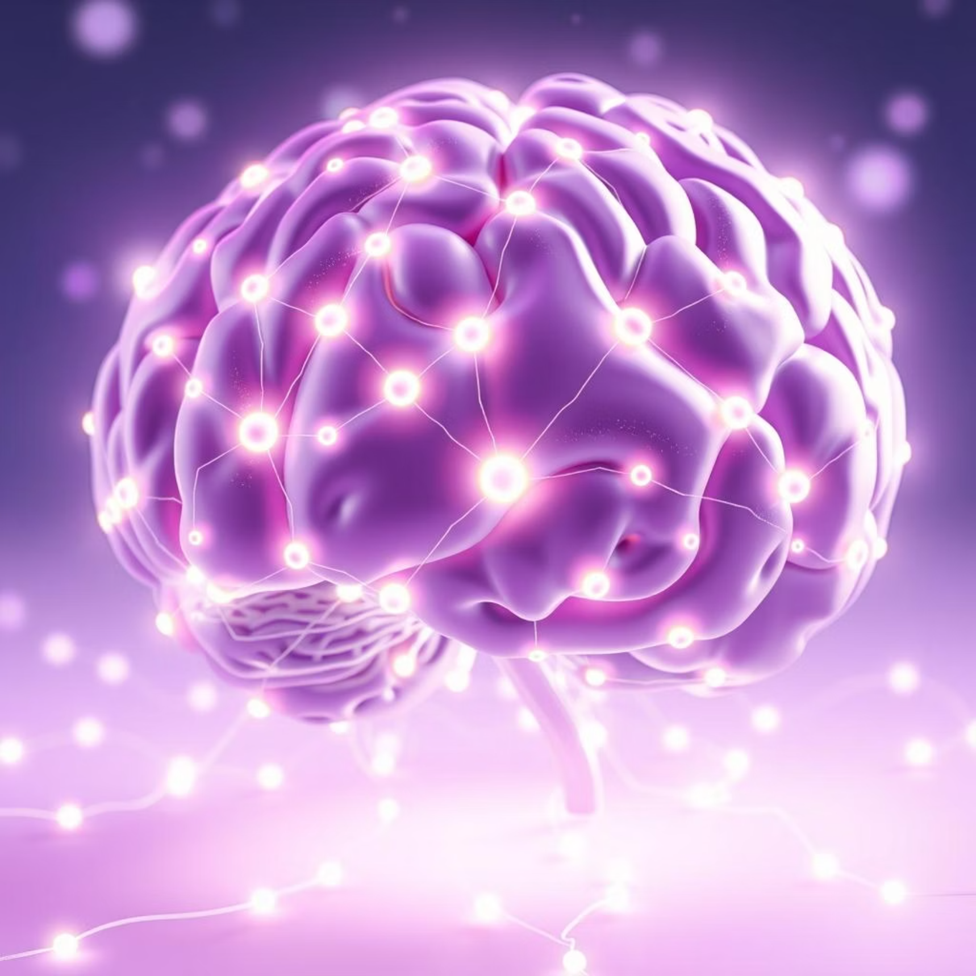
The Future of AI: Toward Superintelligence and Beyond
The journey from ancient automatons to agentic AI is far from over. As AI capabilities grow, so do the profound questions about its ultimate potential and our responsibility in guiding its development.
Superintelligence: Philosophers like Nick Bostrom raise questions about the implications of AI surpassing human cognitive abilities.
Explainable AI (XAI): Research focuses on making AI decisions transparent and understandable, fostering trust and accountability.
Human-AI Collaboration: The future emphasizes synergistic partnerships between humans and AI, leveraging the strengths of both.
Agentic Autonomy: Continuous research into developing safe and beneficial autonomous AI systems is paramount.
The evolution of AI continues to shape the very fabric of humanity and technology, promising unprecedented advancements while demanding careful consideration of ethical implications.

